Slide 1








Power

Slide 2







TABLE OF CONTENTS
01.
02.
power consumption
Batteries
03.
04.
SID
power budget
05.
06.
Regulatore
Converters
07.
08.
Fuses
BMS

Slide 3
POWER
The rate of transfer of electrical energy within a circuit
Power Formula
P = V × 𝑰
Unit : Watt

Slide 4



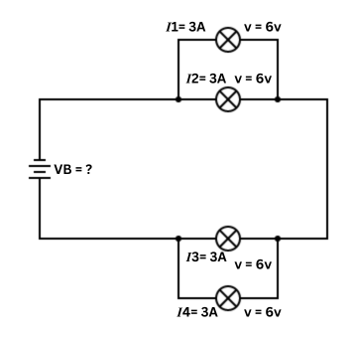


Power
VB = V1 +V2
VB = 6+6
=12 VOLT

Slide 5
Power
𝑰 total = 𝑰 1 +𝑰2 =𝑰3 +𝑰4 = 6 AMP

Slide 6
Power
p = 𝑰 V
p (circuit) =
6 × 12 = 72 watt

Slide 7
Power
VB = 12 volt
𝑰(total) = 6 AMP
P(circuit) = 72 watt

Slide 8






How to power this circuit?

Slide 9

Battaries

Slide 10



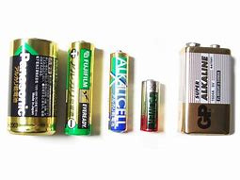
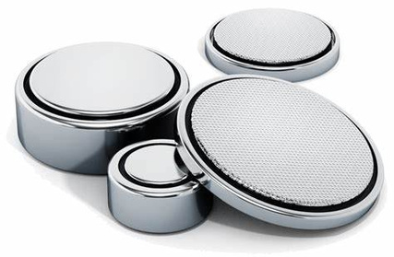
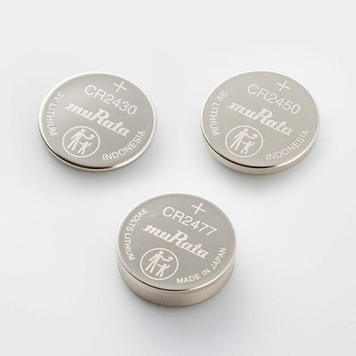
Types of Batteries
Primary Batteries (Non-rechargeable)
Alkaline
Nominal cell Voltage: 1.5V
Air / zinc
Nominal cell Voltage: 1.45V
Lithium / manganese dioxide
Nominal cell Voltage: 3.5V

Slide 11
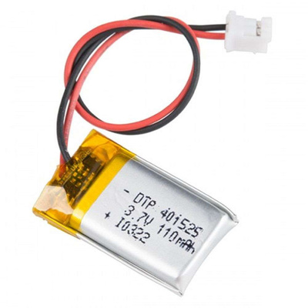
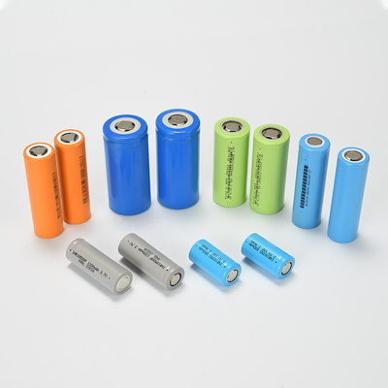
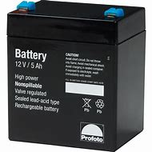
Types of Batteries
Secondary Batteries (Rechargeable)
Li-po
Nominal cell voltage:
3.7 v
Lithium ion
Nominal cell voltage: 3.2-3.85V
LeadAcid
Nominal cell voltage :
2 / 2.1 v

Slide 12



Battery Capacity
Battery Capacity is defined as the product of the electric current flowing in or out of the battery in amperes and the time duration expressed in hours.
Battery Capacity is the measure of the total energy stored in the battery
Battery Capacity = Current (in Amperes) × Time (in hours)
Unit of Battery Capacity: Ah

Slide 13
Battery Capacity
Example:
A 10Ah battery can theoretically supply 10A for 1 hour, 5A for 2 hours, or 1A for 10 hours before being fully discharged.

Slide 14
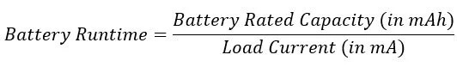
Battery Runtime
The duration for which a battery can power a device continuously before needing to be recharged or replaced.

Slide 15
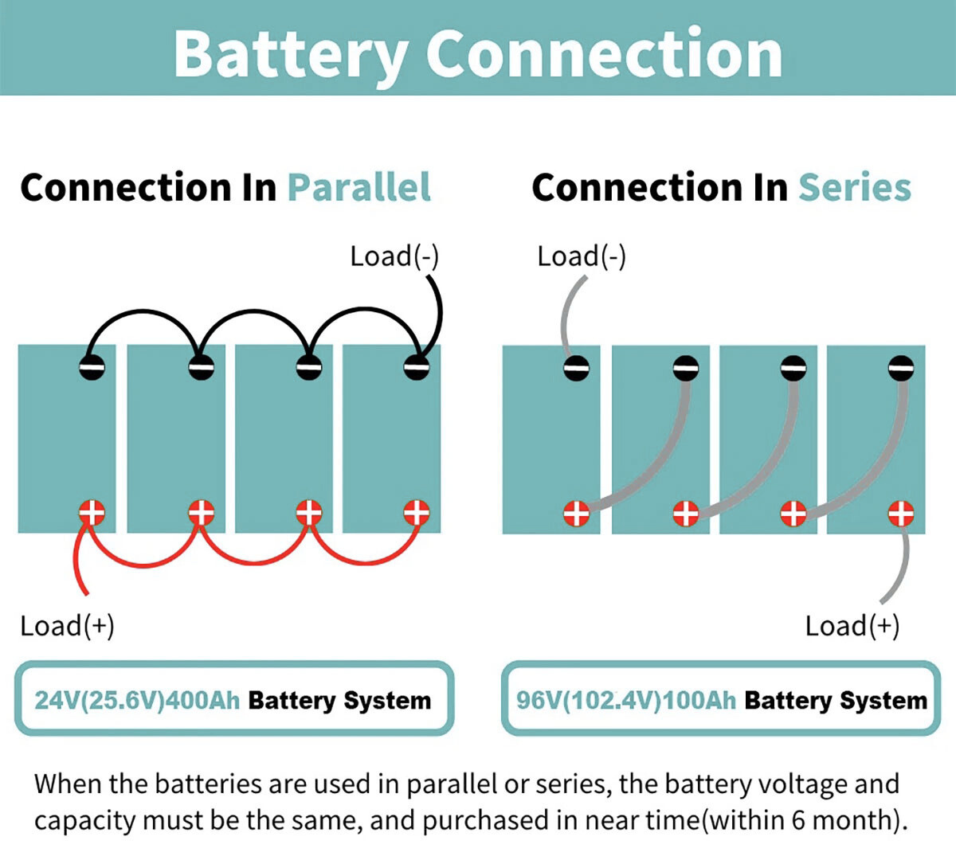
Batteries

Slide 16
Example
Design a circuit for battery provide your needs .
Assume you have cells that have Voltage =3.7 V and Amp-hour = 6800 mAh .

Slide 17
Example
1 ) Num of Cells needed =Vb(circuit) / Vb(actual)
=12 / 3.7
=3.24
=4 cells connected in series

Slide 18
Example
2 ) P(battery)=Vb *Amp-hour =12 * 6800 * 10^(-3)
=81.6 Watt. hour

Slide 19
Example
3 ) Battery runtime =
(6800 x 10 ^-3) / 6 =
1.13 Hours

Slide 20
Regulators

Slide 21
Voltage Regulators
A voltage regulator is designed to automatically ‘regulate’ voltage level. It basically steps down the input voltage to the desired level and keeps that in that same level during the supply. This makes sure that even when a load is applied the voltage doesn’t drop.
Fetures :
Built-in thermal shutdown and short-circuit protection
Output current: typically up to 1A (can go higher with heatsinking)
Dropout voltage: ~2V (so for 5V output, input should be ≥7V)

Slide 22
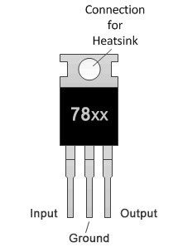
Voltage Regulators

Slide 23
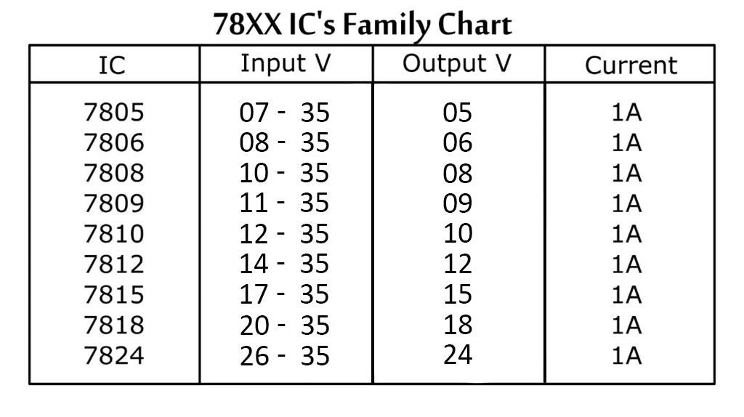
Voltage Regulators

Slide 24
Converters

Slide 25
Buck converter (Step-down)
How do Buck converters work?
It works by switching a transistor (MOSFET) on and off rapidly.
storing energy in an inductor.
using a diode and capacitor to smooth out the voltage.

Slide 26
Buck Converter (Step_down)
How do Buck converters work?
When Switch is ON :
Current flows from the input source through the switch, then through the inductor, and finally to the load.
At the same time, the inductor is storing energy by building a magnetic field.
The diode is reverse biased (OFF), so it doesn't conduct.

Slide 27
Buck Converter (Step_down)
How do Buck converters work?
When Switch is OFF :
The current path from the source is cut off
But the inductor doesn't like sudden changes in current, so it keeps the current flowing by releasing its stored energy.
The current flows from the inductor → through the diode → to the load → back to the inductor.
Now, the inductor is powering the load on its own, and the voltage is lower than the input.

Slide 28
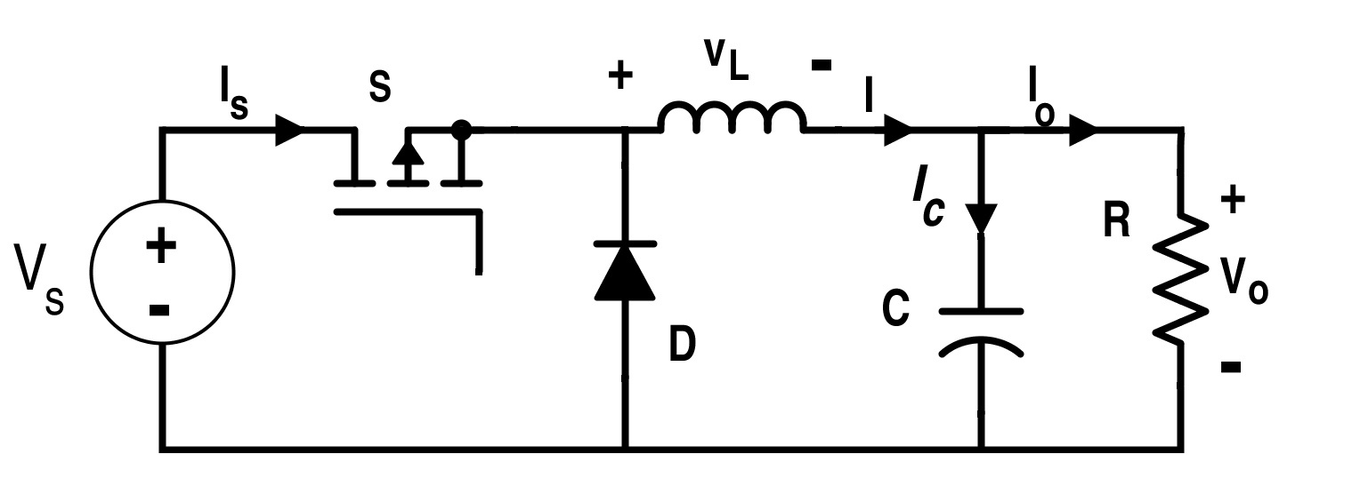
Buck converter circuit

Slide 29
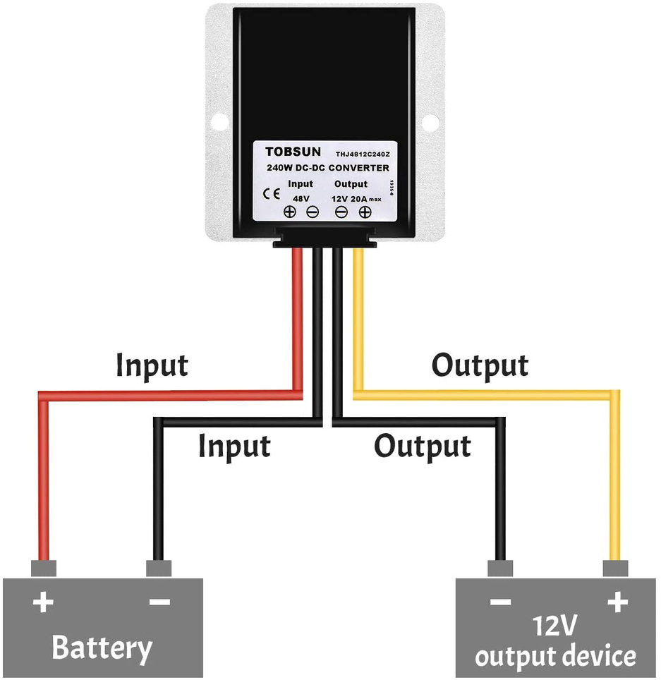
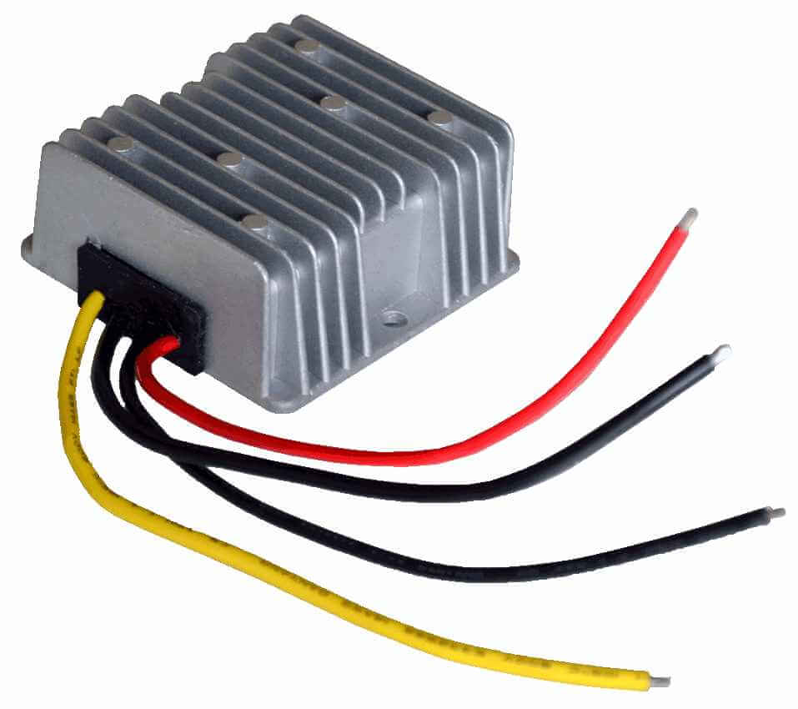
48V – 12 V CONVERTER

Slide 30
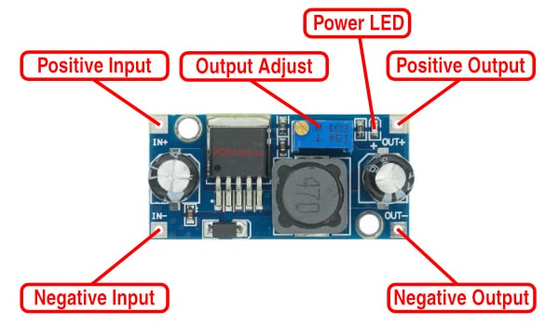
12V – 5 V CONVERTER

Slide 31
Boost Converter (Step_up)
How do Boost converters work?
When Switch is ON :
Current flows from the input source through the inductor to ground (through the transistor).
The inductor builds a magnetic field and stores energy.
using a diode and capacitor to smooth out the voltage.

Slide 32
Boost Converter (Step_up)
How do Boost converters work?
When Switch is OFF :
The current path through the transistor is suddenly broken.
The inductor resists the sudden drop in current by reversing its polarity
This adds its stored energy on top of the input voltage.
The combined voltage (Vin + Vinductor) pushes through the diode to the load and capacitor.
The capacitor stores energy and provides a steady output voltage.

Slide 33
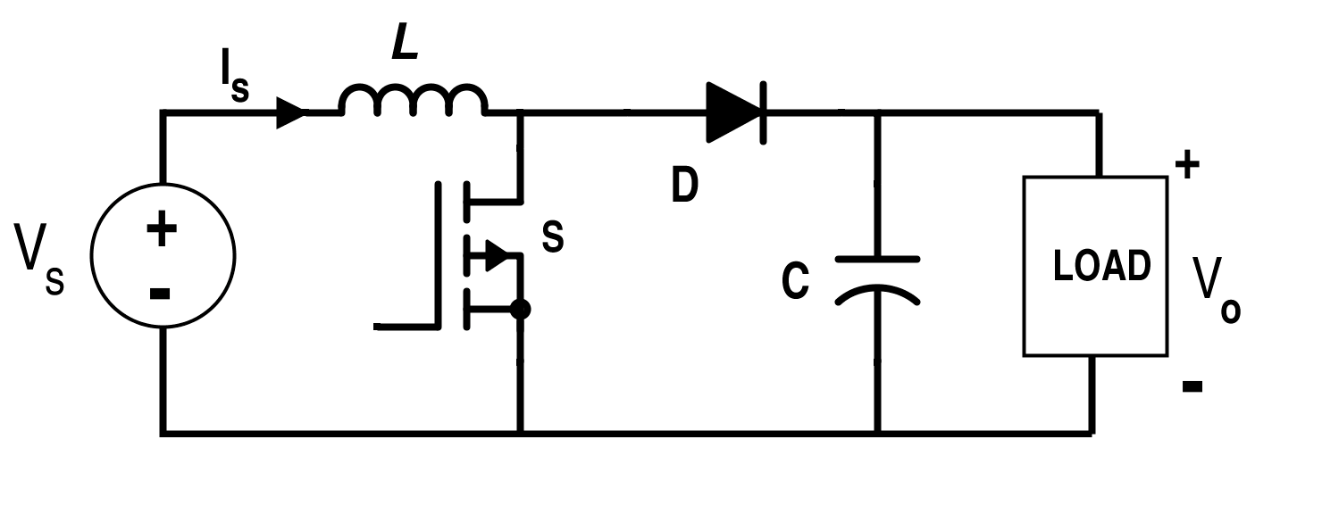
Boost converter circuit

Slide 34
Buck-Boost Converter
A buck boost converter is a DC-to-DC power supply that can increase or decrease voltage based on the needs of the circuit.
A buck-boost converter is a combination of a buck converter and a boost converter.

Slide 35
SID diagram
System Integration Diagram

Slide 36
SID
A System Integration Diagram (SID) shows how all parts of the ROV are connected together. It includes the battery, motors, controller (like Arduino), sensors, camera, and other devices.
It helps you understand how power and signals flow in the system, and makes it easier to build, test, and fix the ROV.
ORCA SID diagram ⟶

Slide 37
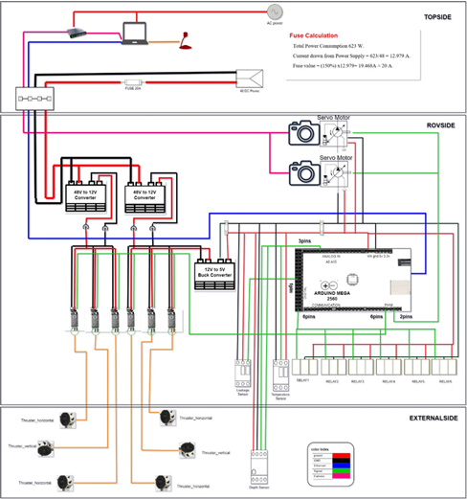
SID

Slide 38
power Budget

Slide 39
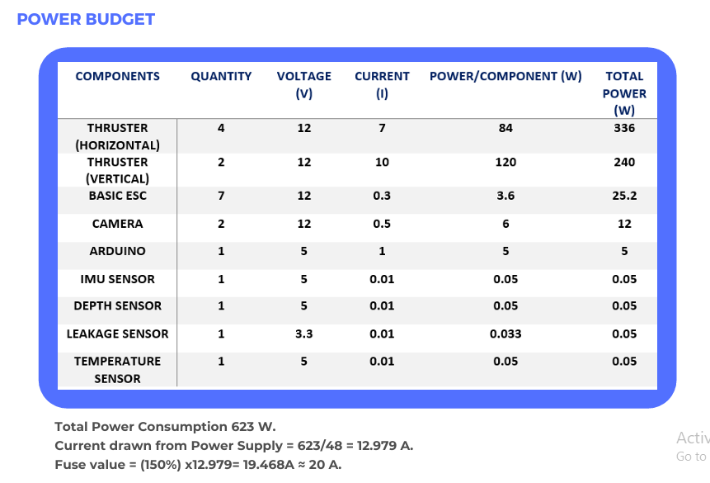

Slide 40
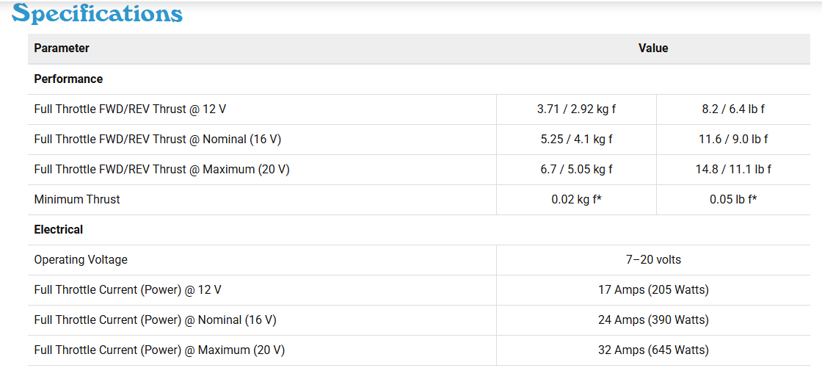
Thrusters (T 200)

Slide 41
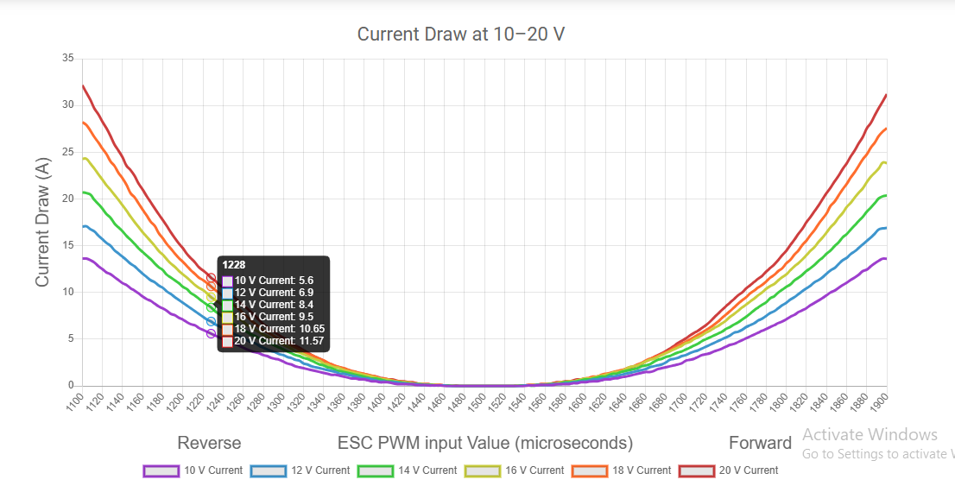
Thruster (T 200)

Slide 42
Thruster (T 200)
Thruster Operating current ≈ 7
Thruster Operating voltage = 12
Power = 12 × 7 = 84 watt
Total power for 4 Thrusters =
4 × 84 = 336 watt

Slide 43
Fuses

Slide 44


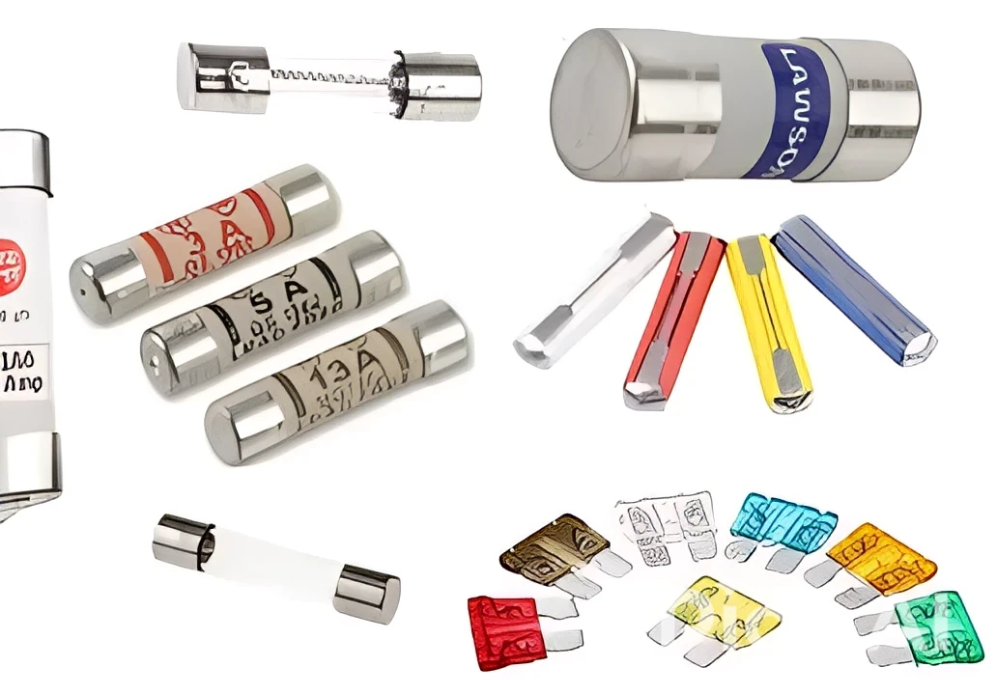



Fuses
A fuse is a simple safety device used to protect electrical circuits from overcurrent .

Slide 45
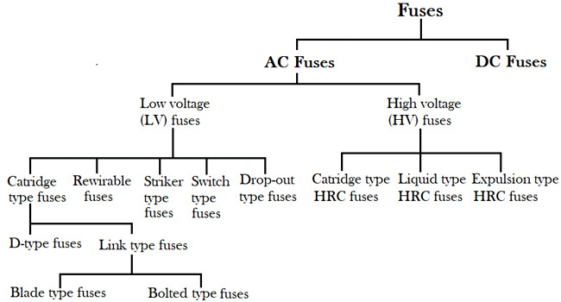
Types of Fuses

Slide 46
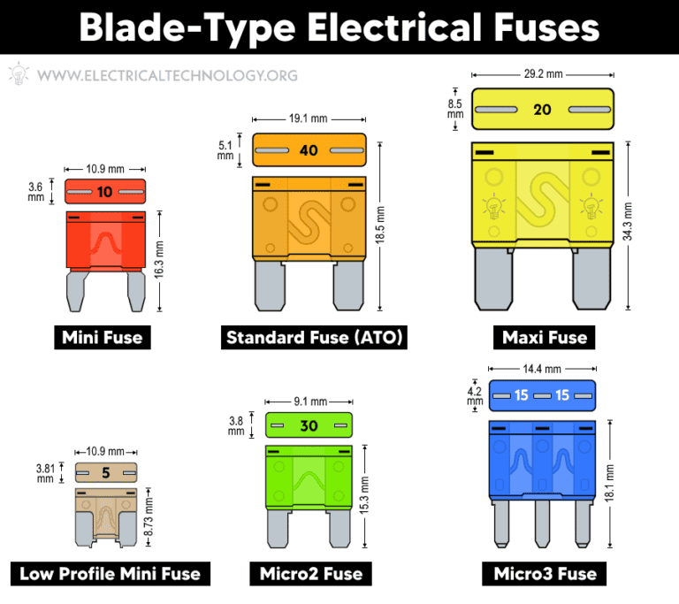
how to compute Fuses size ?
Fuse Size (A) = Current (A) × Safety Factor
Safety Factor ⟶ 1.25 : 2

Slide 47
Fuses
Total Power Consumption = 623 watt
Current drawn from Power Supply = 623 / 48 = 12.979 Amp
Fuser value = 1.5 × 12.979 = 19.468 Amp ≈ 20 Amp

Slide 48
BMS
Battery Management System

Slide 49
BMS
BMS is an electronic system that monitors and controls the chargeable batteries in order to operate safly and efficiently

Slide 50
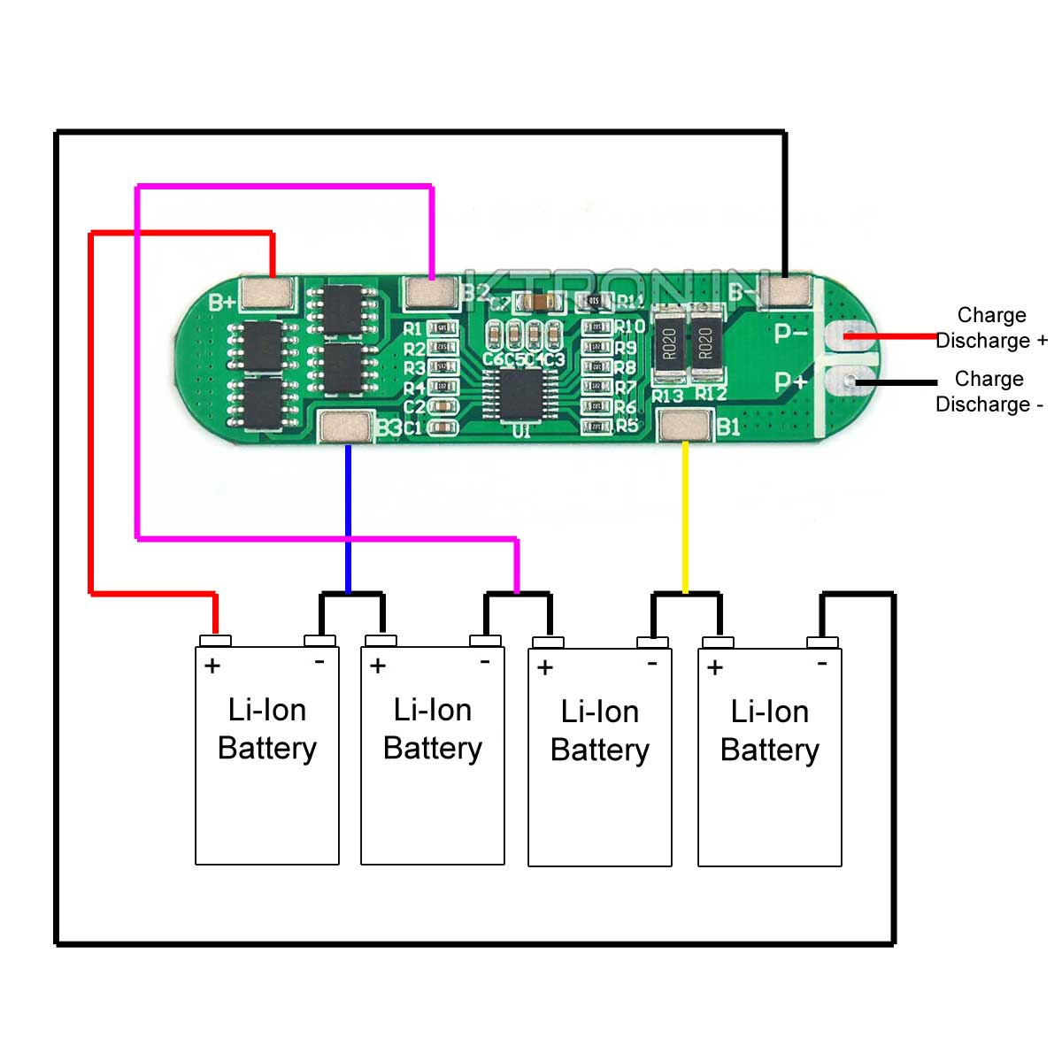
BMS

Slide 51
BMS
Cell Monitoring:
Cell monitoring is the process of continuously measuring and tracking the voltage, temperature, and sometimes internal resistance of each individual battery cell in a battery pack. This is done to ensure all cells are operating safely, within their limits, and are balanced with each other.

Slide 52
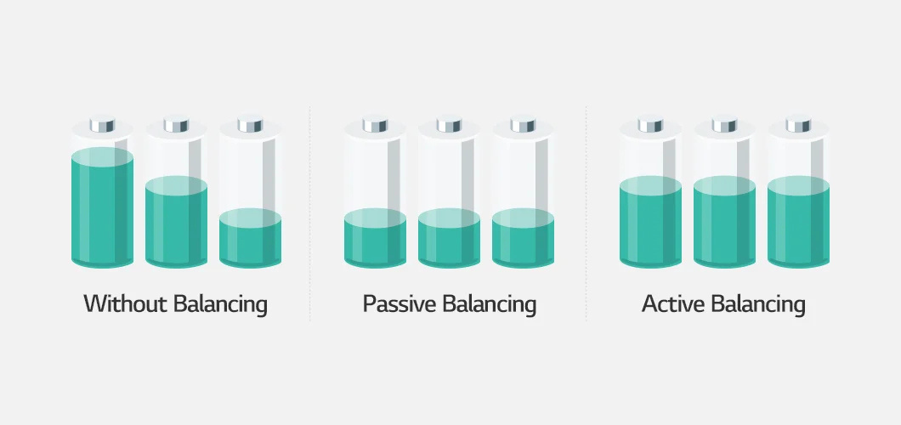
BMS
Cell Balancing:
Cell balancing is the process of equalizing the voltage levels of individual battery cells in a battery pack to ensure all cells charge and discharge evenly.

Slide 53
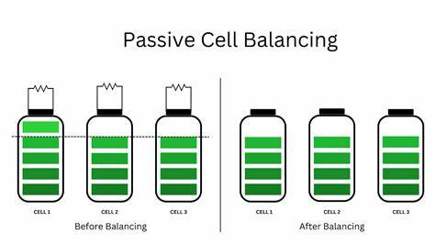
BMS
Techniques used in cell balancing

Slide 54
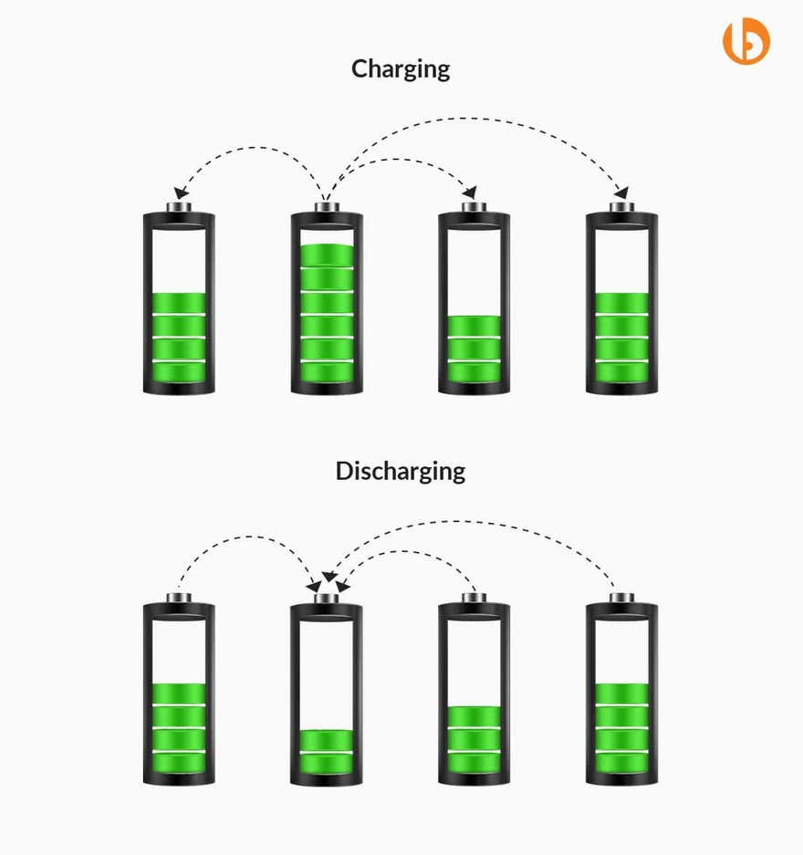
BMS
Techniques used in cell balancing
Active cell balancing

Slide 55
BMS
Techniques used in cell balancing
 | Passive | Active
Definition | It works by dissipating excess charge from more charged cells as heat through external resistors | Energy transfers from a higher voltage to a lower voltage cell within the battery.
Pros | Simple architecture, cost effective method. | Energy is transferred from one cell to another. So, less energy wastage.
Cons | The capacity of pack is limited by weakest cell | Complex architecture, additional cost of electronics

Slide 56
TASK

Slide 57
Task
Create a power budget for an ROV equipped with 6 motors (4 horizontal, 2 vertical) and 6 ESCs.
Select and include two sensors for the ROV.
Calculate fuse for the system.
Make SID for the ROV.
Make a presentation includes all above.

Slide 58




Thanks ❤

